Slide 1

HUMAN RESOURCES
SCC BENEFITS 2024
Healthcare- Medical/Dental/Vision
Southern California conference of seventh-day Adventists

Slide 2
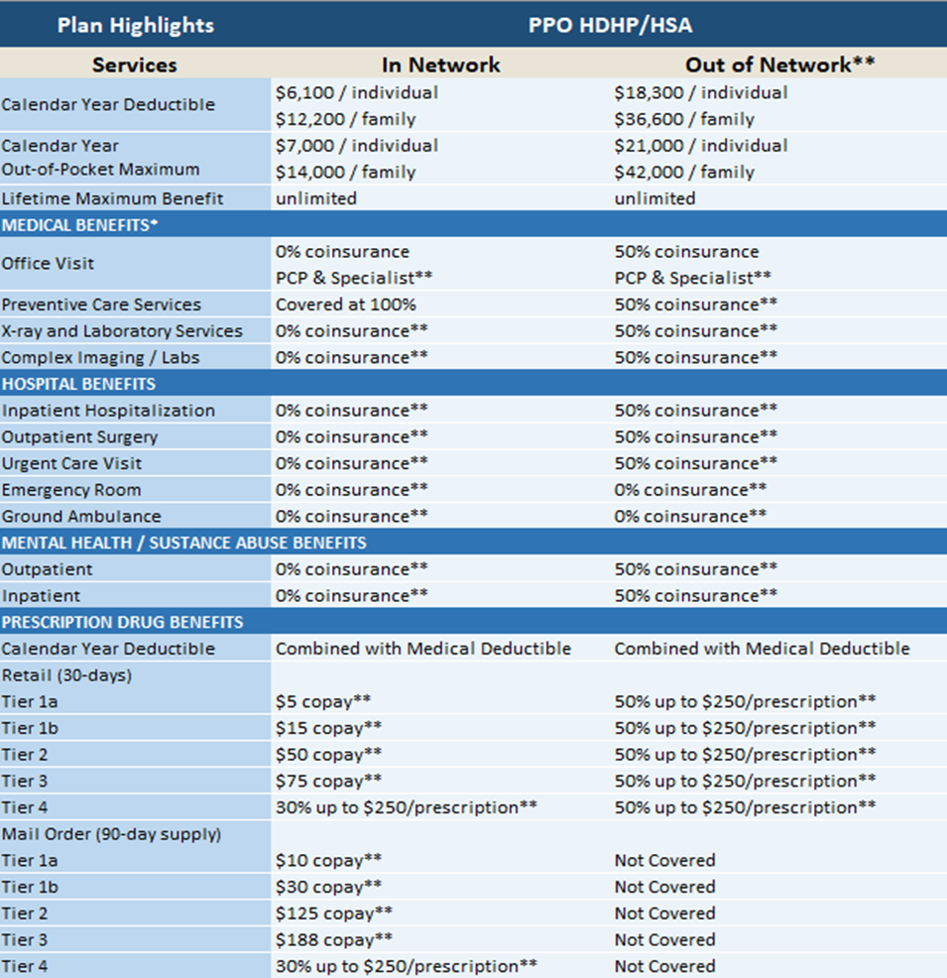
HUMAN RESOURCES
New 2024 Plan
Anthem 6100 Plan
Single:
Deductible $6,100
OOPM $7,000
Family:
Deductible $12,200
OOPM $14,000

Slide 3
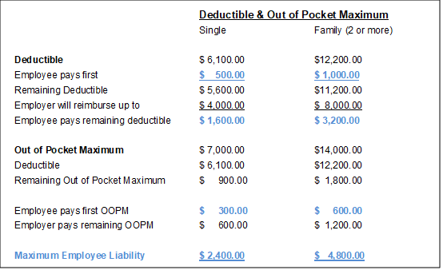
HUMAN RESOURCES
HOW SCC WILL HELP WITH YOUR
DEDUCTIBLE & OUT OF POCKET MAXIMUM

Slide 4
HUMAN RESOURCES
EMPLOYEE REIMBURSEMENT
PROCESS TOWARDS DEDUCTIBLE
$500
$4,000
$1,600
$6,100
Employee responsibility towards deductible
Maximum amount covered by SCC (reimbursed through Foy and Associates)
Remaining employee responsibility towards deductible
Total deductible

Slide 5
HUMAN RESOURCES
OUT OF POCKET MAXIMUM
(OOPM)
$6,400-$7,000
$6,100- $6,400
$7,000+
Total deductible, plus $300 is employee’s responsibility towards OOPM
Remaining $600 covered by SCC (reimbursed through Foy and Associates)
100% covered by Anthem

Slide 6
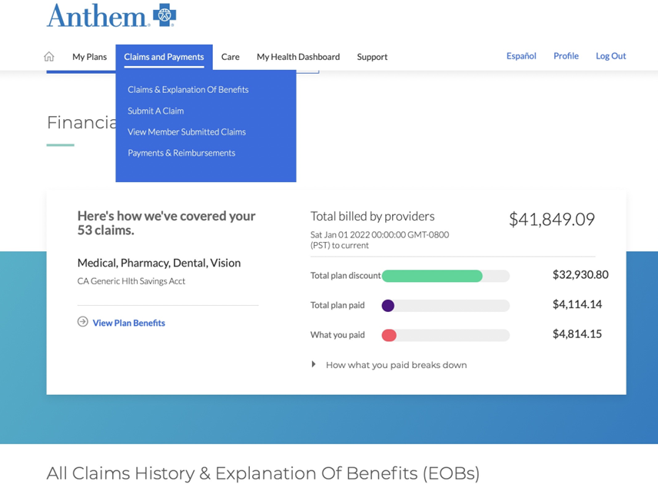
Human resources
HOW TO REQUEST
FOR REIMBURSEMENTS
Step 1:

Slide 7
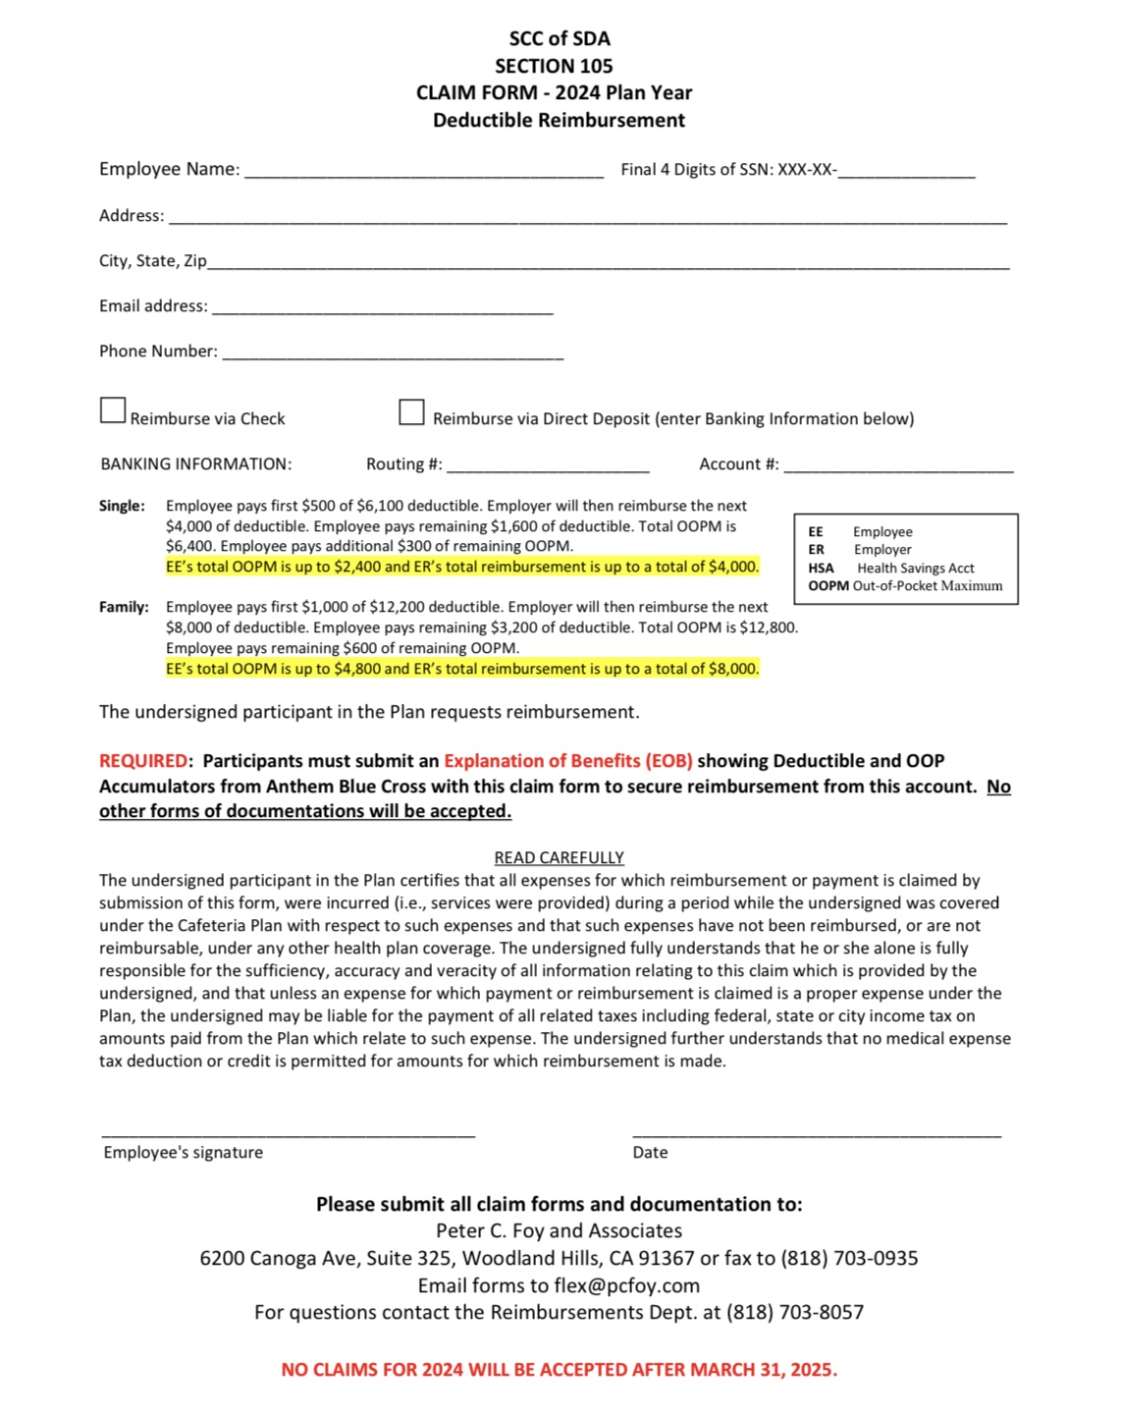
Human resources
HOW TO REQUEST
FOR REIMBURSEMENTS
Step 2:
Fill out Claim Form- 2024 Year
Submit Claim Form & EOB to Foy & Associates
Deadline March 31, 2025

Slide 8
HUMAN RESOURCES
No employer HSA contribution for 2024
How employees can save towards Deductible needs through their HSA
You can elect to set aside pre-tax up to $4,150 for individual coverage and up to $8,300 for family coverage.
If you are age 55 or older, you may make an additional “catch-up” contribution of $1,000 per year.

Slide 9

HUMAN RESOURCES
Employee cost for 2024

Slide 10
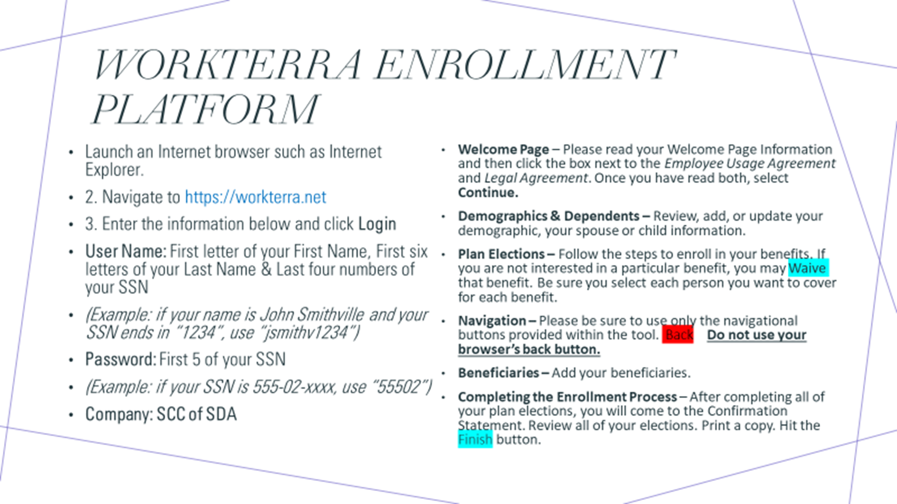
Southern California conference of seventh-day Adventists

Slide 11
HEALTHCARE
2024 OPEN ENROLLMENT
December 1-11, 2023
Southern California conference of seventh-day Adventists

